Slide 1

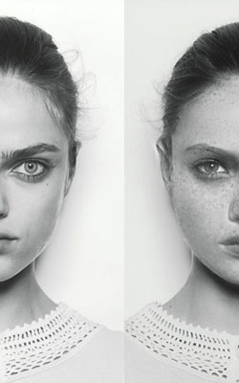

Preparing Open Educational Pathways for the Next Generation of Learners
Creating-010 Digital Badges
Creating—10
Digital Badges

Slide 2

Notes:
ROB

Slide 3
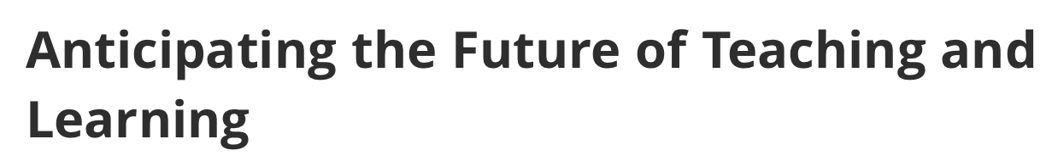
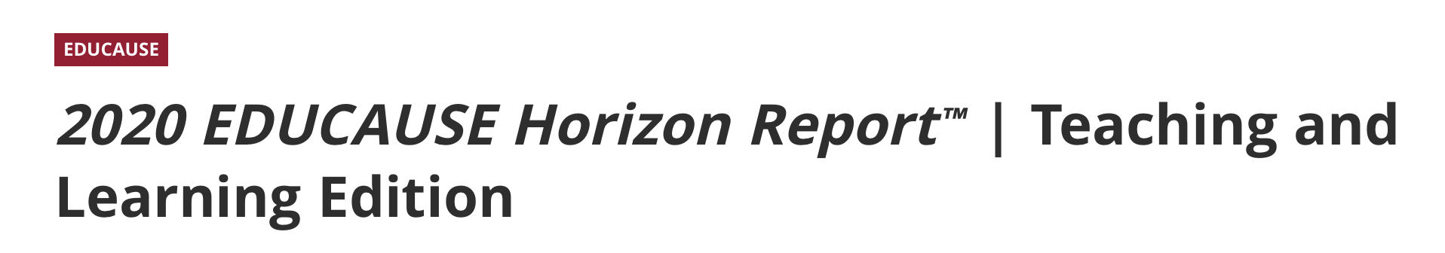
Digital technology is disrupting education
with trends like increased use of social recommendations (smart engagement) and circumvention
of traditional publishers (open access)
https://library.educause.edu/resources/2020/3/2020-educause-horizon-report-teaching-and-learning-edition
Notes:
ROB

Slide 4
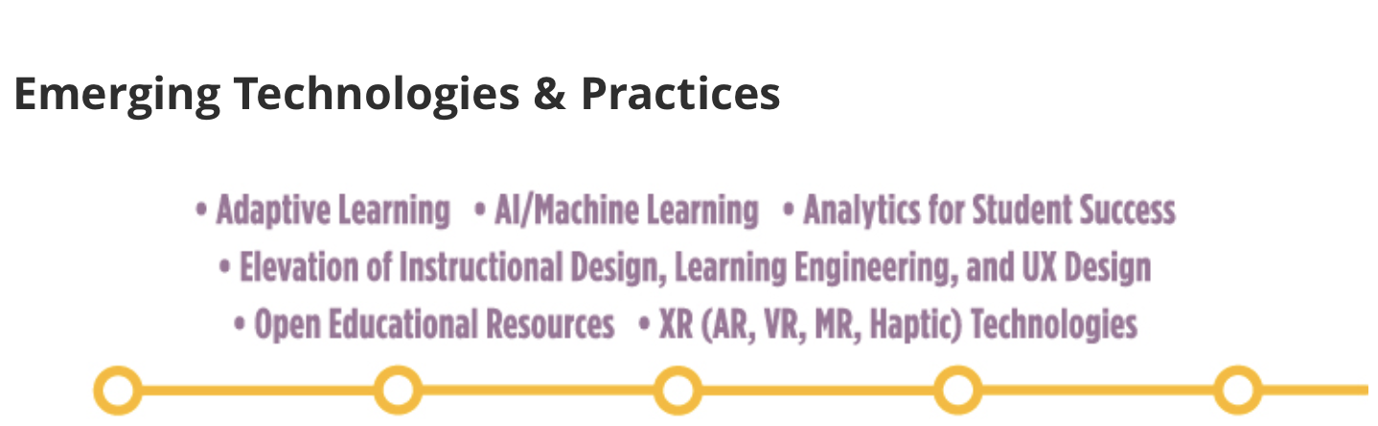
https://library.educause.edu/resources/2020/3/2020-educause-horizon-report-teaching-and-learning-edition
Notes:
ROB

Slide 5
Key Outcome”
Stadslab Rotterdam started in 2019
an Open Badge initiative
—as part of the SURF EduBadges pilot—
to provide open educational pathways for
the next generation of learners.

Slide 6
Digital Badges”
Semantics aside,
open badges or micro-credentials
will be the upcoming gold standard for learners
—students and teachers alike—
as to create their own pathways
to the careers of the future,
some of which have yet to be imagined.

Slide 7
Notes:
ROB

Slide 8
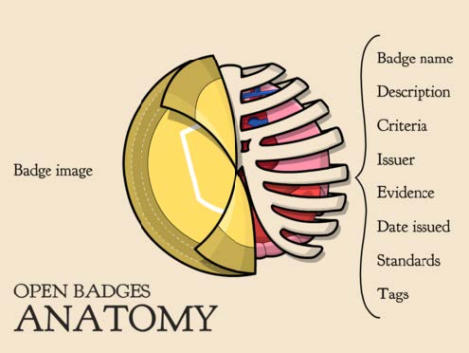
Notes:
ROB

Slide 9
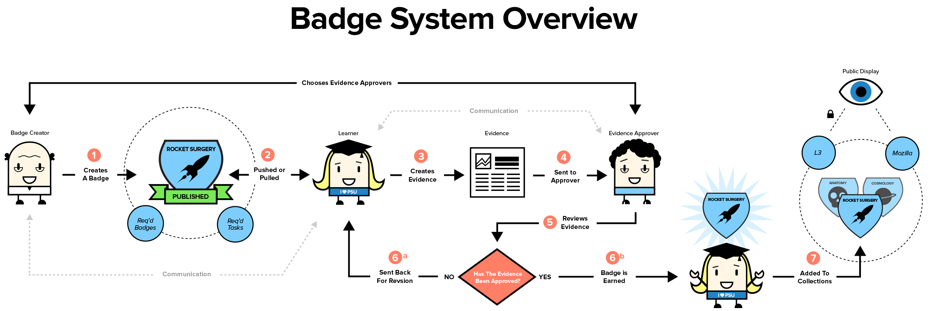
http://sites.psu.edu/informationliteracybadges/wp-content/uploads/sites/13774/2014/07/L3_System_Overview.jpg
Notes:
ROB

Slide 10
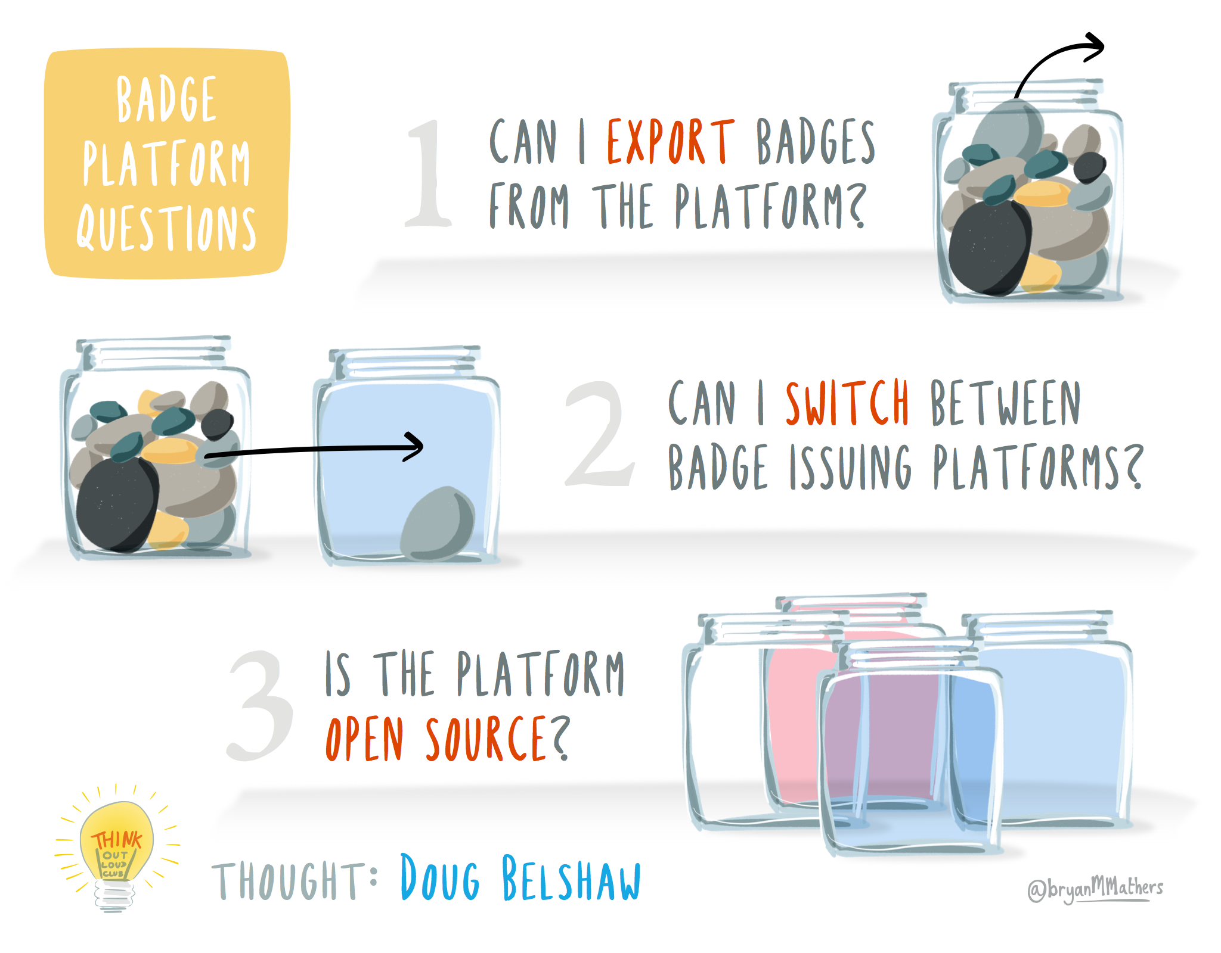
Notes:
ROB

Slide 11

Notes:
ROB

Slide 12
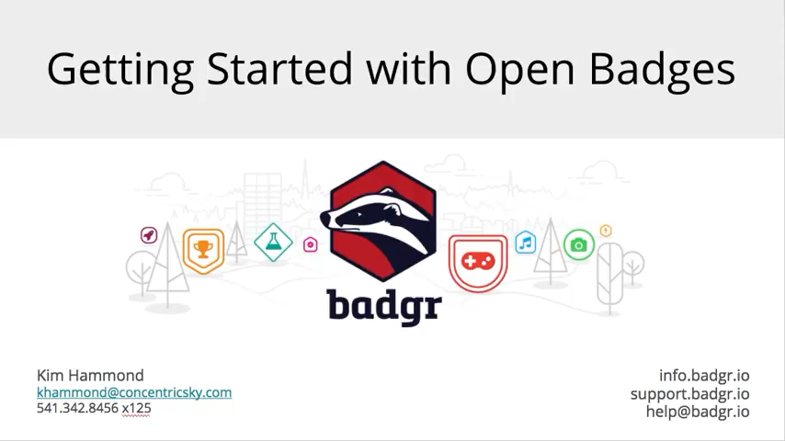
Notes:
ROB

Slide 13
Hypothesis

Slide 14
Digital Badges By means of Open Badges, learners can navigate educational pathways and stack badges in so-called digital backpacks to earn certifiable competencies, indicating progressive learning achievement.
Notes:
ROB

Slide 15
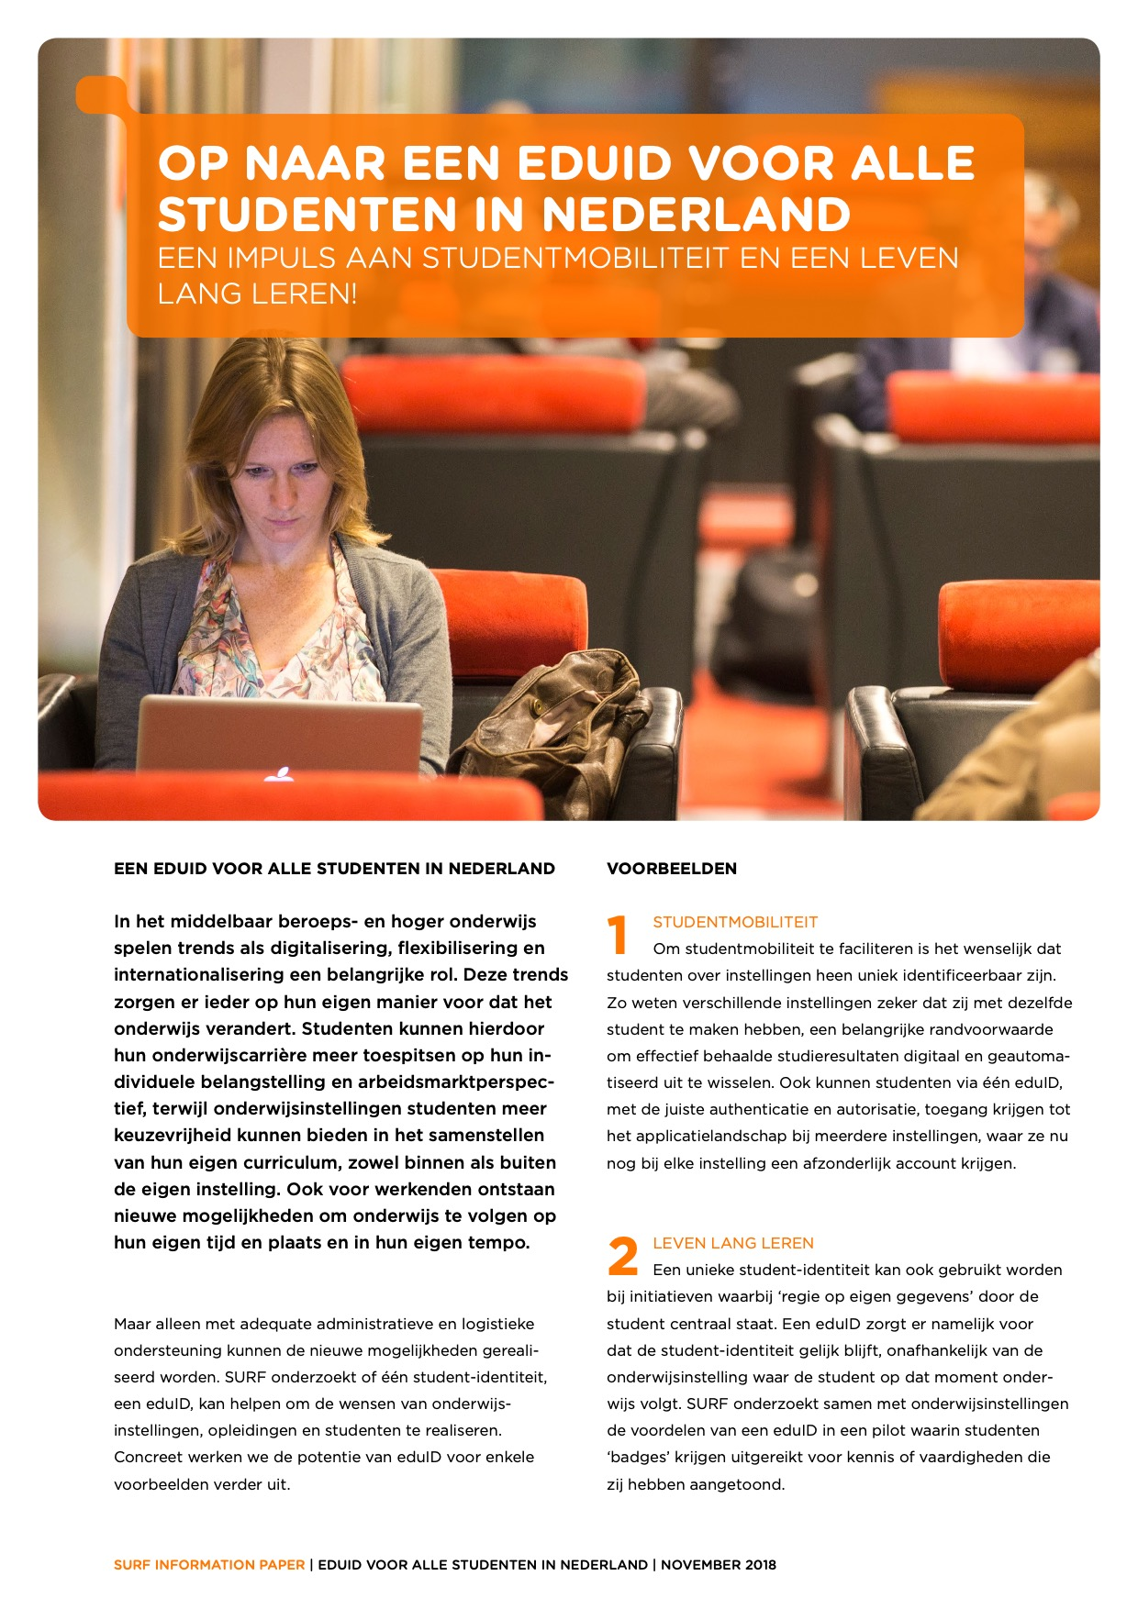
Notes:
ROB

Slide 16
What kind of
Digital Badges
are you using?

Slide 17
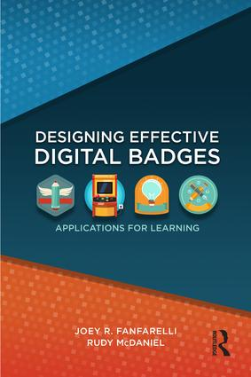
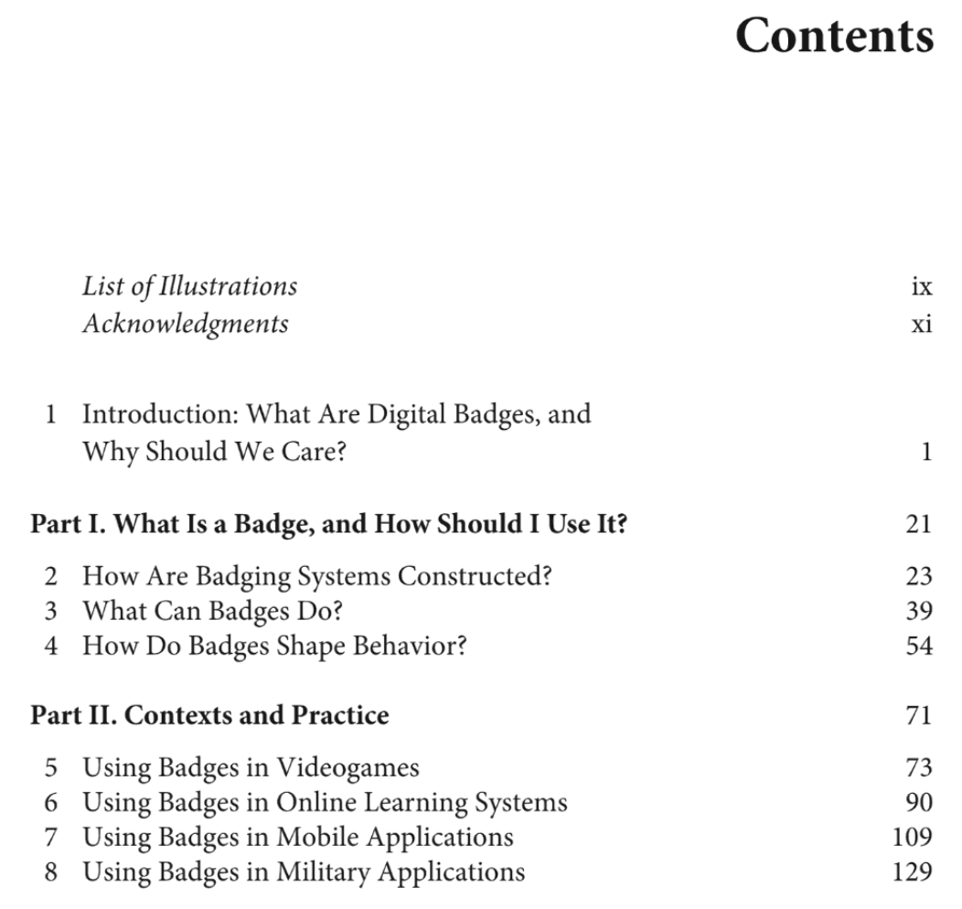
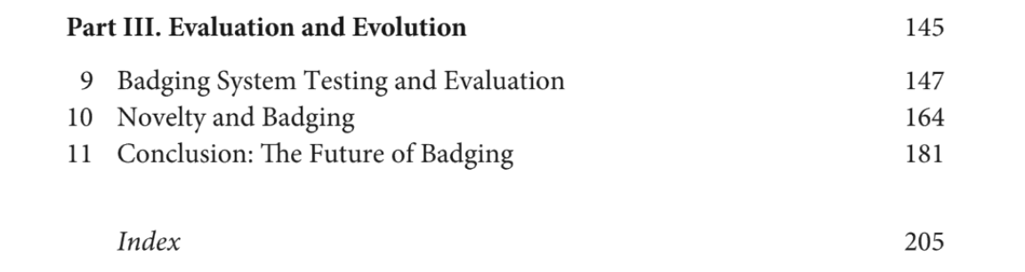
Notes:
ROB

Slide 18
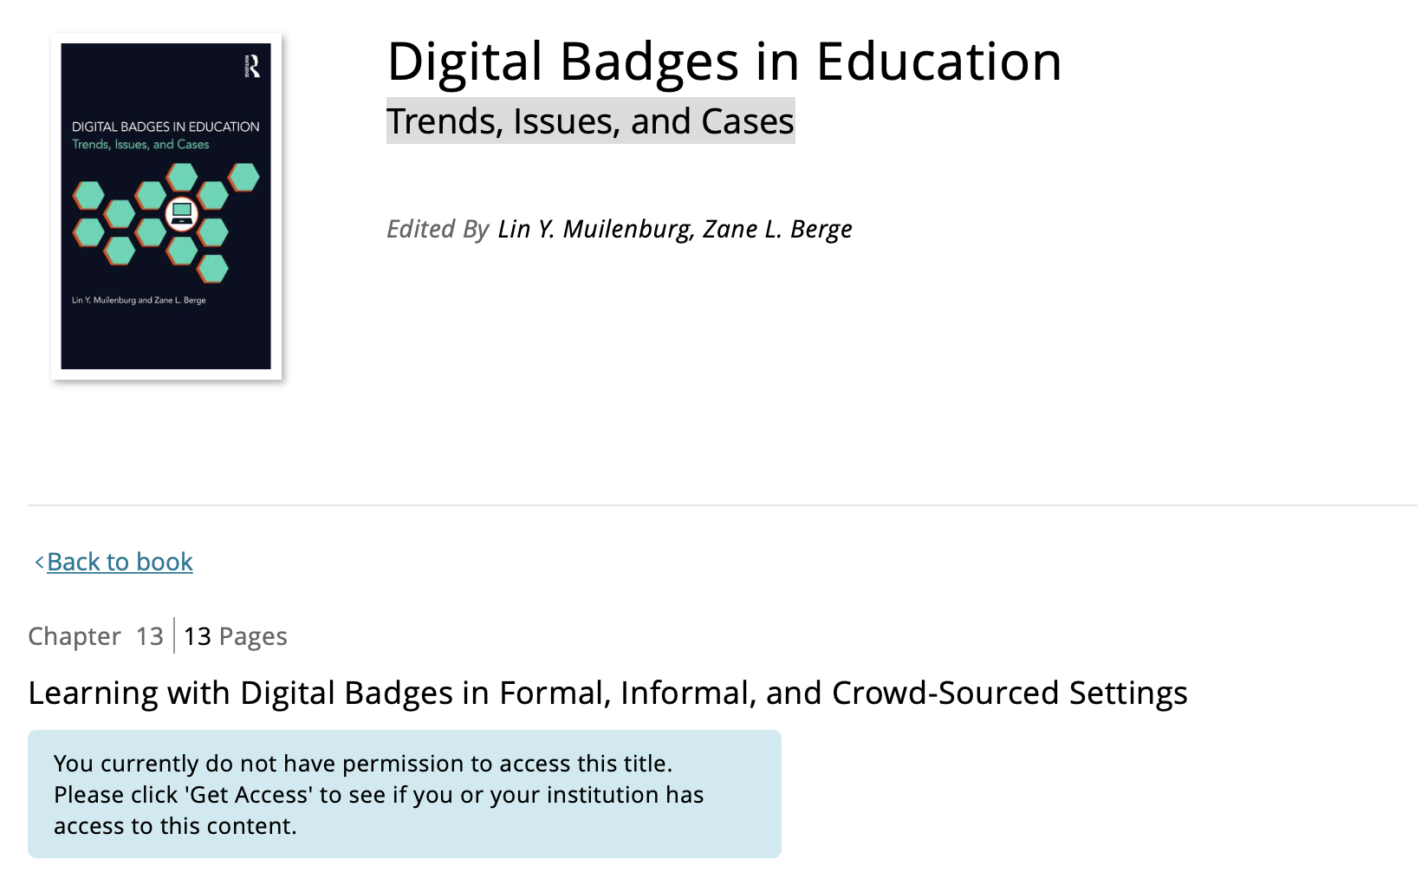
https://www.taylorfrancis.com/books/e/9781315718569/chapters/10.4324%2F9781315718569-19
Notes:
ROB

Slide 19
Requirement
Analysis
What do you need to
Issue Digital Badges?

Slide 20
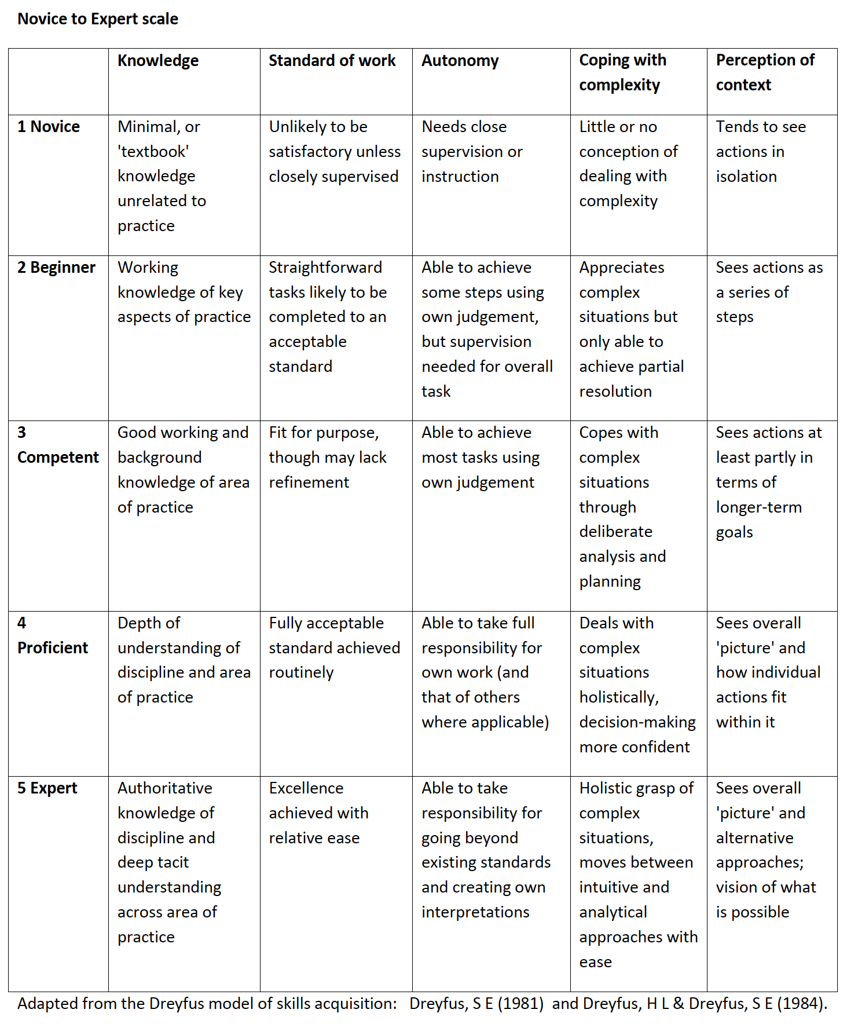

Slide 21
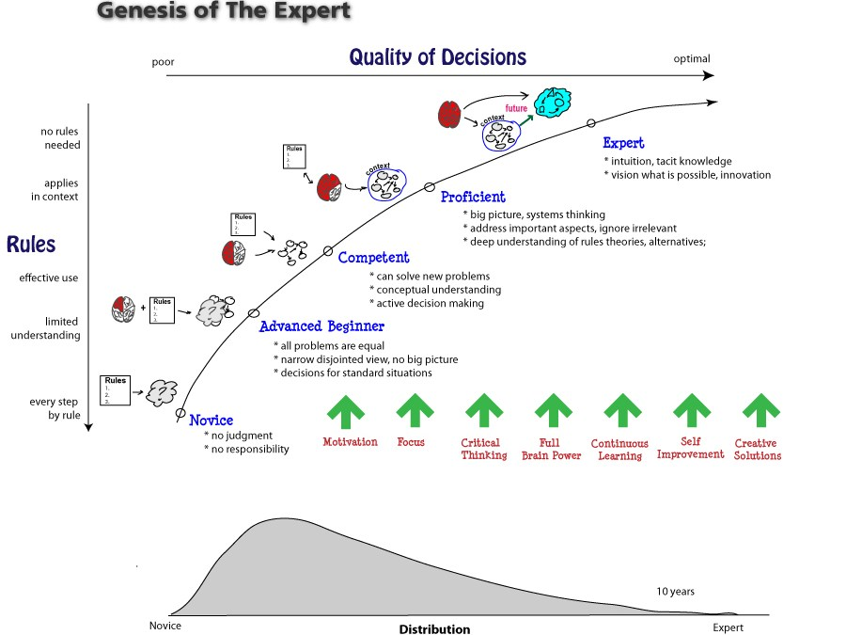
Notes:
ROB

Slide 22
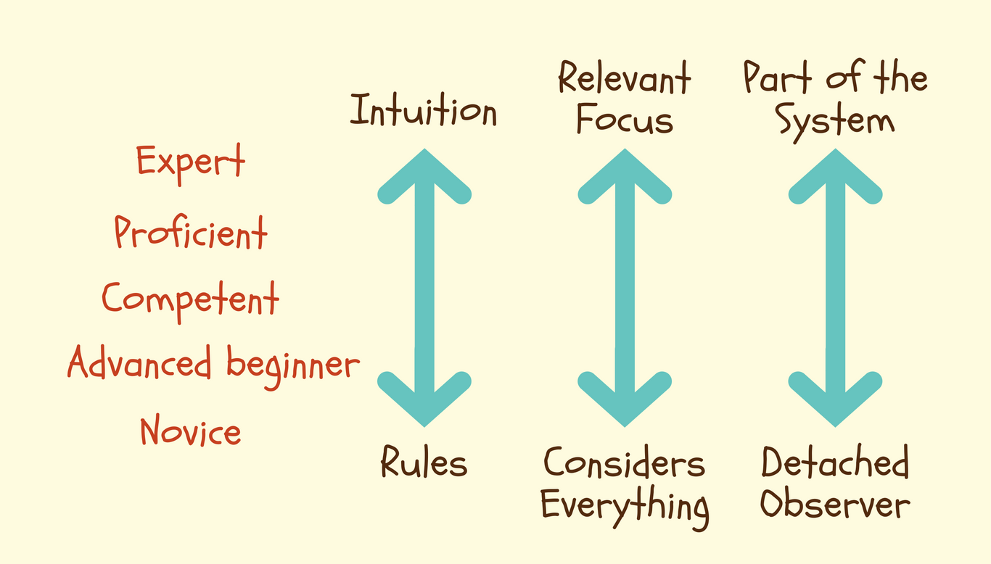
Notes:
ROB

Slide 23
http://f-wg.de/en/2017/02/dreyfus-model-of-skill-acquisition/
Notes:
ROB

Slide 24
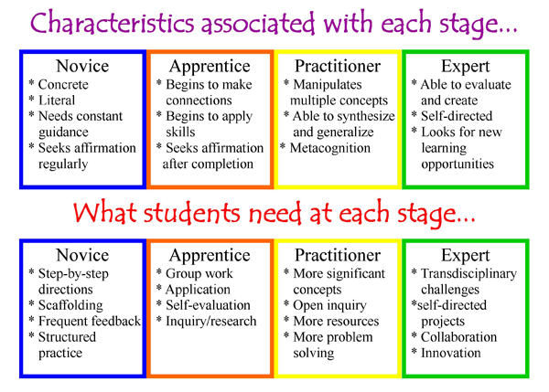
Notes:
ROB

Slide 25
Meta Analysis
What does the literature say
About Digital Badges?

Slide 27
Notes:
ROB

Slide 28
Notes:
ROB

Slide 29
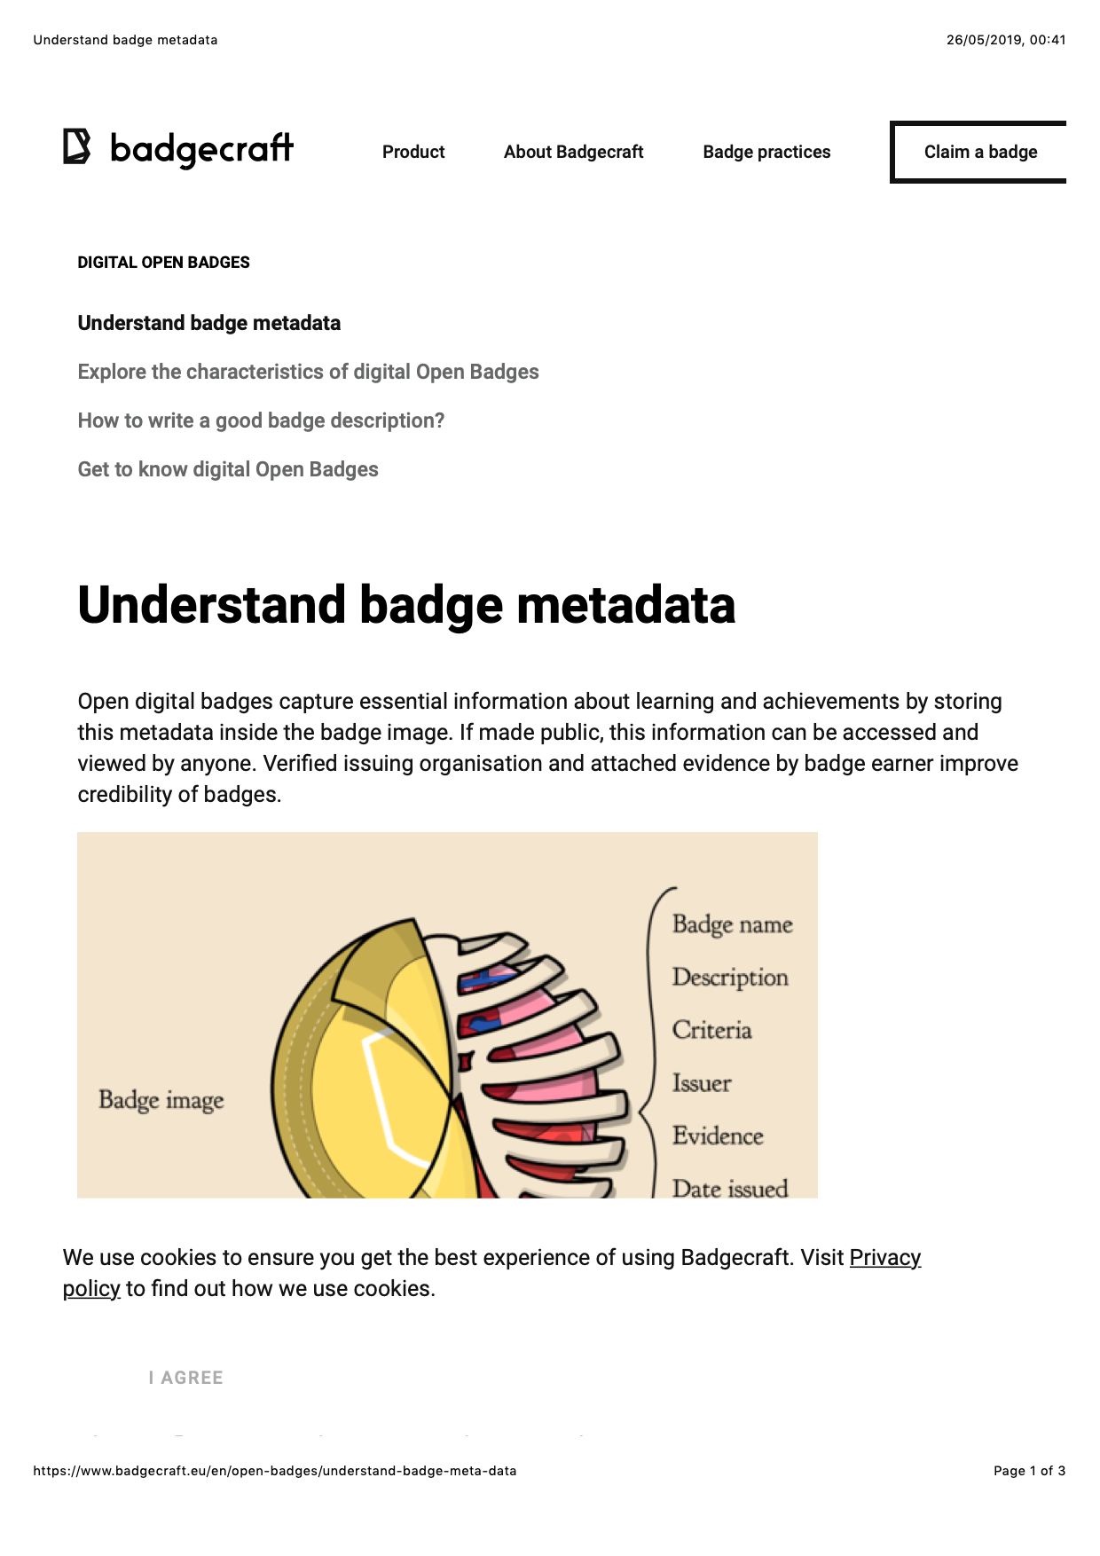
Notes:
ROB

Slide 30
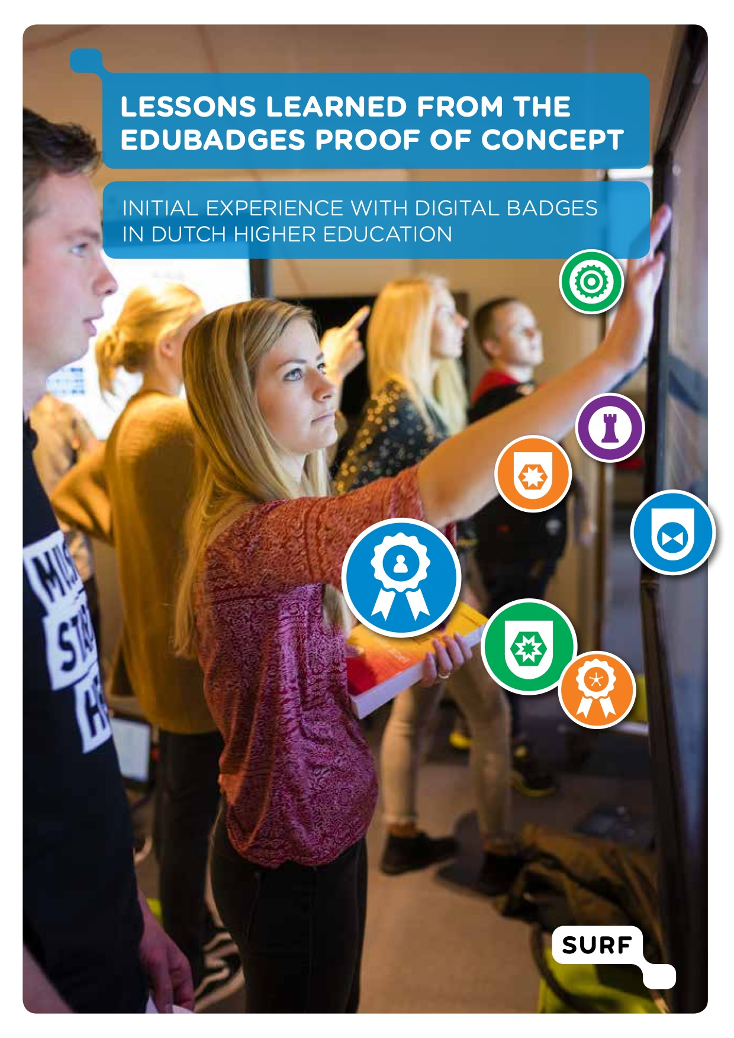
Notes:
ROB

Slide 31
Measurement
Outcome

Slide 32
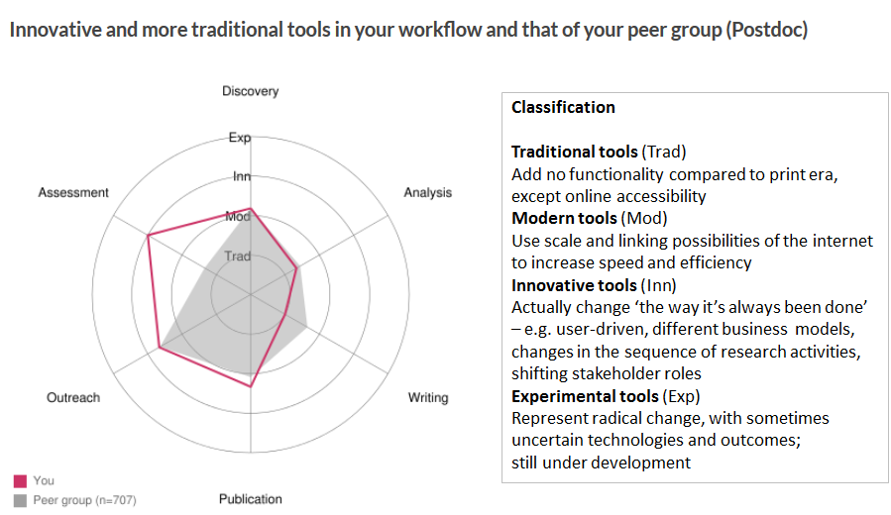
Notes:
ROB

Slide 33
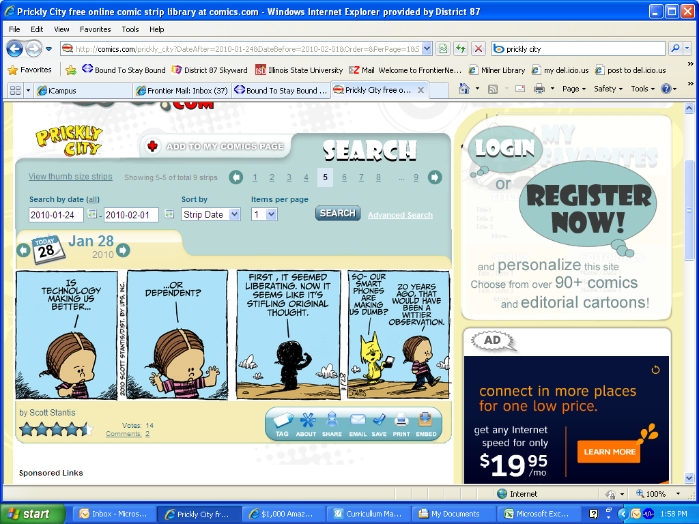

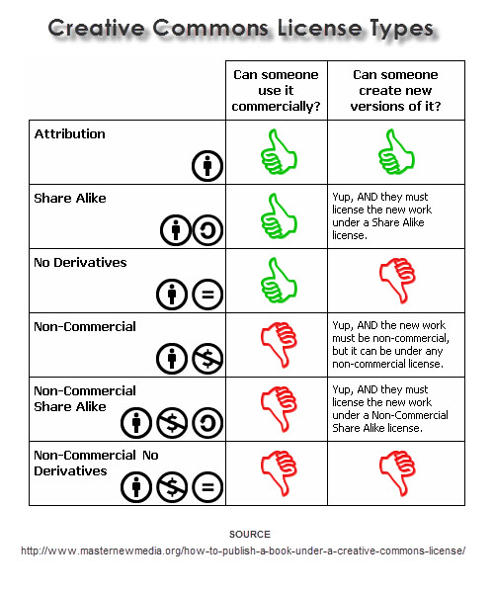
This lesson was developed by:
Robert Frans van der Willigen
CMD, Hogeschool Rotterdam
March 2020
http://creativecommons.org/licenses/by-nc-sa/3.0/
This lesson is licensed under a Creative Commons Attribution-Share-Alike license. You can change it, transmit it, show it to other people. Just always give credit to RFvdW.
http://empoweringthenatives.edublogs.org/2012/03/15/creative-commons-licenses/
http://creativecommons.org/licenses/

Slide 34
Notes:
ROB

Slide 35
Notes:
ROB

